Slide 1
In the name of Allah, most gracious and merciful
Object Oriented Concepts &Design with Lab
Lecture – 4
Inheritance base method

Slide 2
Base method
The base keyword is used to access members of the base class from within a derived class:
Call a method on the base class that has been overridden by another method.
Specify which base-class constructor should be called when creating instances of the derived class.
A base class access is permitted only in a constructor, an instance method, or an instance property accessor.
It is an error to use the base keyword from within a static method.
The base class that is accessed is the base class specified in the class declaration. For example, if you specify class ClassB : ClassA, the members of ClassA are accessed from ClassB, regardless of the base class of ClassA.

Slide 3
using System;
public class A // This is the base class.
{
public A(int value)
{
// Executes some code in the constructor.
Console.WriteLine("Base constructor A()");
}
}
public class B : A // This class derives from the previous class.
{
public B(int value)
: base(value)
{
// The base constructor is called first.
// ... Then this code is executed.
Console.WriteLine("Derived constructor B()");
}
}
class Program
{
static void Main()
{
// Create a new instance of class A, which is the base class.
// ... Then create an instance of B.
// ... B executes the base constructor.
A a = new A(0);
B b = new B(1);
}
}

Slide 4
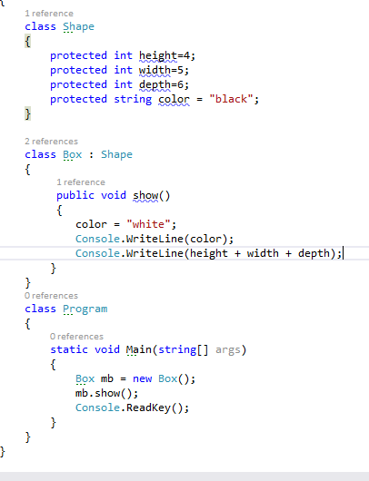

Slide 5
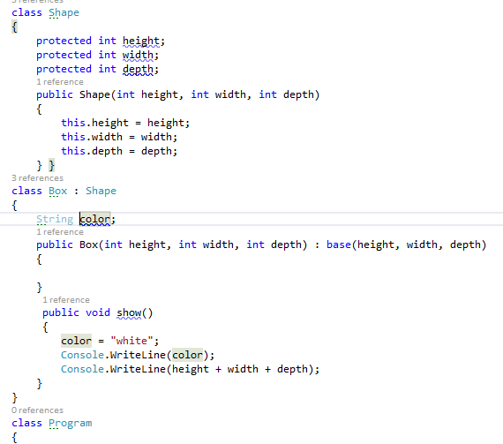

Slide 6
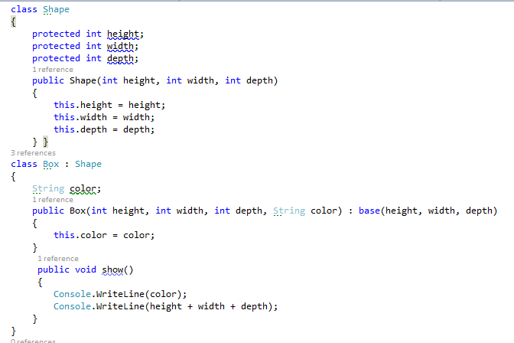

Slide 7
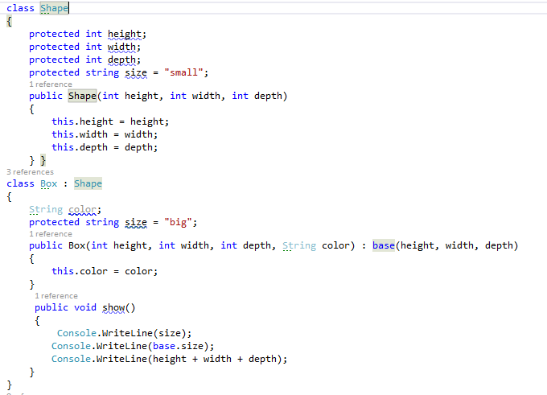

Slide 8
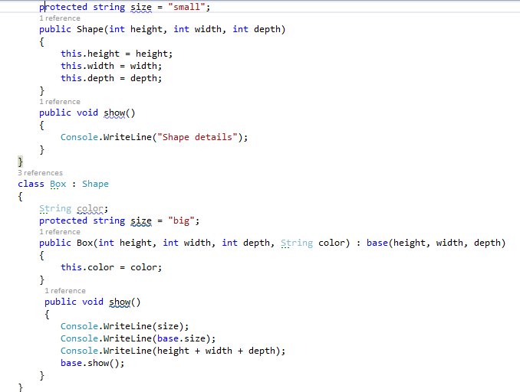

Slide 9
Base vs this
using System;
class Net
{
public int _value = 6;
}
class Perl : Net
{
public new int _value = 7;
public void Write()
{
// Show difference between base and this.
Console.WriteLine(base._value);
Console.WriteLine(this._value);
}
}
class Program
{
static void Main()
{
Perl perl = new Perl();
perl.Write();
}
}

